Slide 1

ICS474 PRESENTATION ​
Mohammed Alnaim​
Yasser Abdulaal ​
Malik Alharbi ​

Slide 2
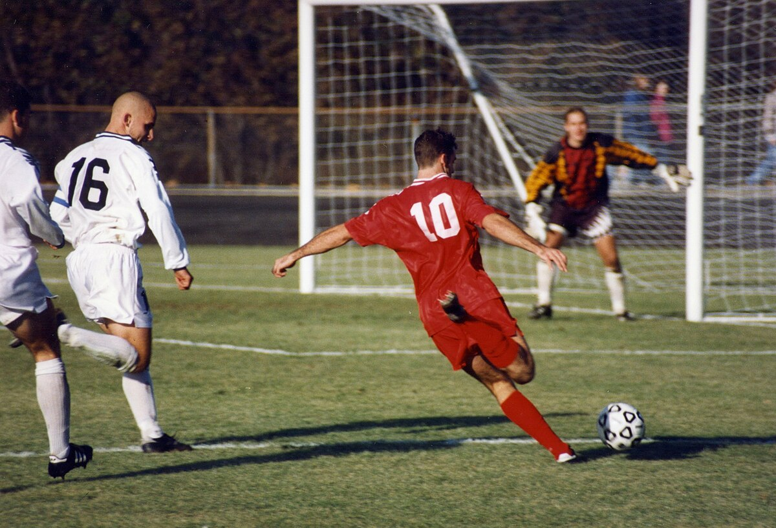
DATASET OVERVIEW ​
The soccer dataset contains data from various leagues, players, and matches.
​
Has data of 25000+ matches and 10000+ players
​
Has a total of 7 tables

Slide 3

FEATURE DESCRIPTION​
Match table, contains data on each match, such as team, player positions​
​
Player table, contains information about individual players. (height, weight, age)​
​
Player_attirubutes table (rating, skills, physical attributes)

Slide 4
STATISTICAL SUMMARY​
Some interesting insights we can get from the dataset From 11 thousand players
Average weight: 76.37 kg ​
Most common weight: 76.2 kg ​
Range: 53 kg to 110 kg
Average height: 181.87 cm ​
Most common height: 182 cm​
Range: 157.48 cm to 208.28 cm

Slide 5
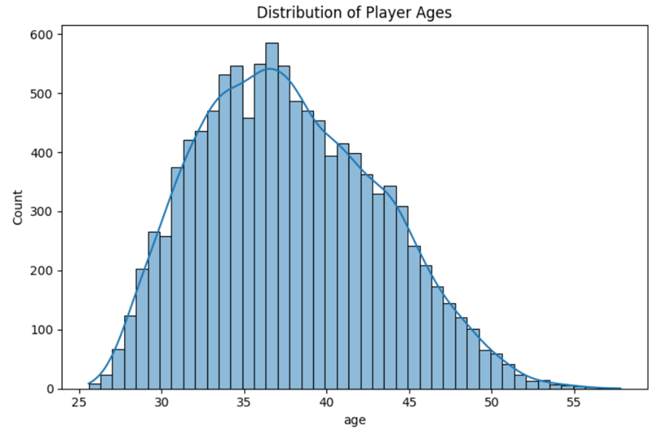
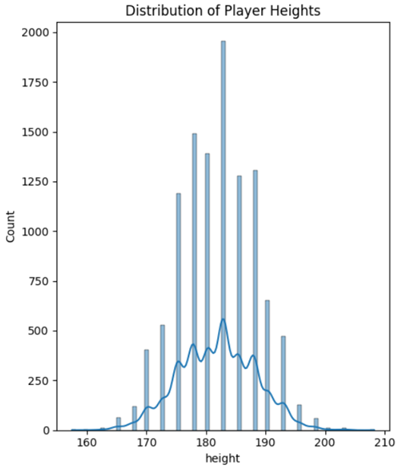
DATA VISUALIZATION

Slide 6
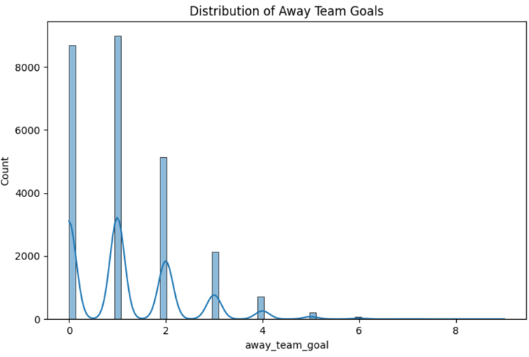
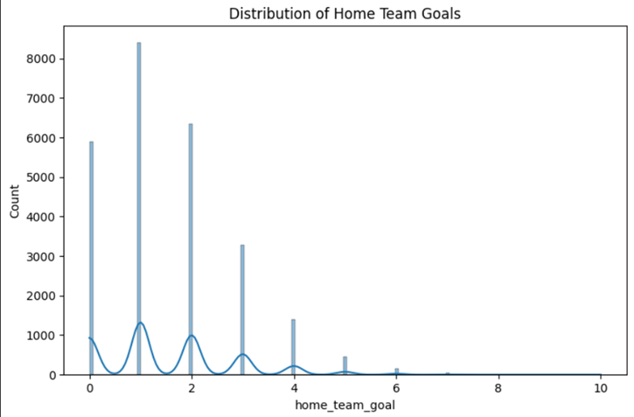
DATA VISUALIZATION

Slide 7
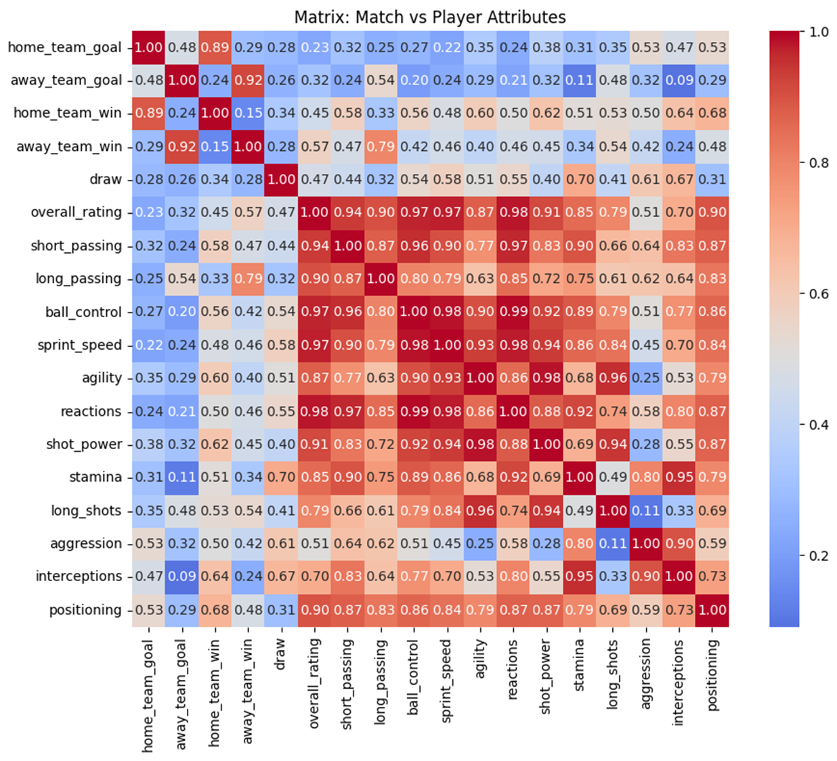
CORRELATION MATRIX

Slide 8
HANDLING MISSING DATA AND ENCODING CATEGORICAL VARIABLES
Handling Missing Data:
Mode imputation for categorical (e.g., preferred_foot).
Mean imputation for numerical (e.g., player statistics).
Outcome:
Missing values resolved, categorical data ready for modeling.
Encoding Categorical Variables:
One-Hot Encoding: For nominal variables like preferred_foot.
Label Encoding: For ordinal variables (attacking_work_rate).

Slide 9
SCALING AND CHOOSING IMPORTANT FEATURES
Feature Scaling:
Standardization (mean = 0, std = 1) for gradient-based models.
Min-Max Scaling for distance-sensitive models (e.g., KNN).
Outcome:
Focus on impactful features, reducing complexity and overfitting.
Feature Selection:
Techniques: Correlation analysis, Random Forest feature importance.
Selected Features: Overall rating, Key Skills (crossing, finishing, short_passing), Goalkeeping Attributes, and defensive skills.

Slide 10
DATA SPLITTING, MODEL TRAINING, AND EVALUATION
Data Splitting:
Evaluation Metrics:
80% training, 20% testing for robust evaluation.
R² Score: Variance explained by the model.
MAE: Average prediction error.
RMSE: Penalizes large errors.
Modeling:
Outcome:
Algorithms: Linear Regression (baseline), Random Forest, Gradient Boosting.
Trained with default parameters, then tuned for better performance.
High R² and low errors indicate strong model performance.

Slide 11
MODEL PERFORMANCE AND EVALUATION

Slide 12
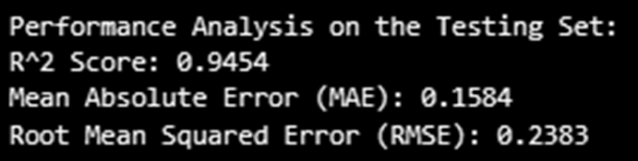
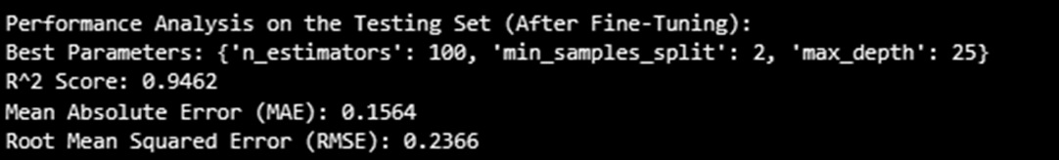
MODEL PERFORMANCE AND EVALUATION
Initial Results:
The models—Random Forest, Gradient Boosting, and Linear Regression—showed good initial performance, with Random Forest performing the best with R² of 0.9454.
Model Improvement:
Fine-tuning with hyperparameter adjustments improved R² from 0.9454 to 0.9462.

Slide 13
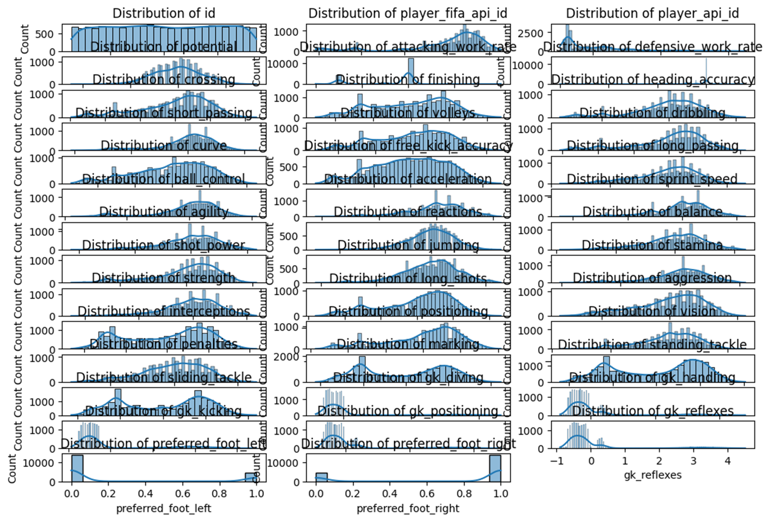
DATA DISTRIBUTION

Slide 14
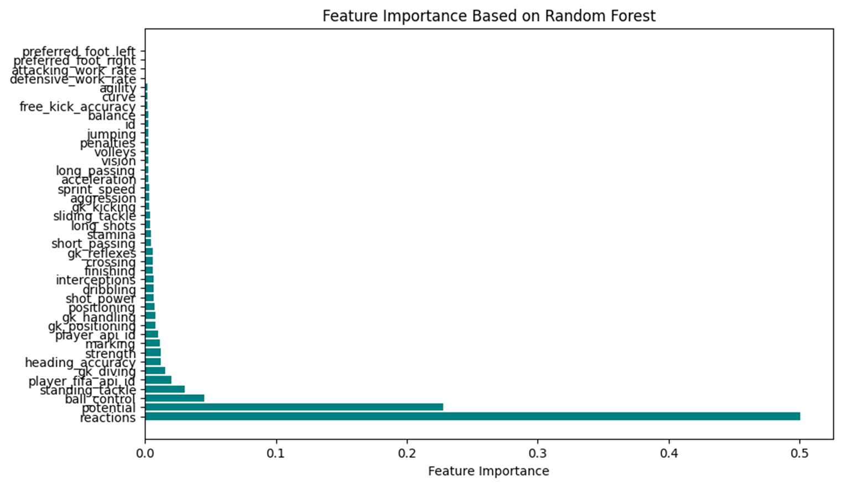
FEATURE IMPORTANCE

Slide 15
THANK YOU

